Slide 1
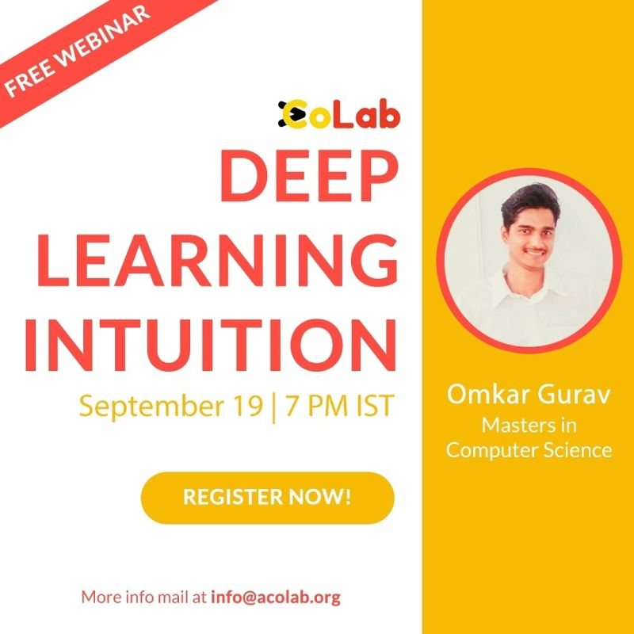

Slide 2

Intents
Why Neural Network…Invention
How Neural Network…y = m*x+c
Where Neural Network…Applications

Slide 3
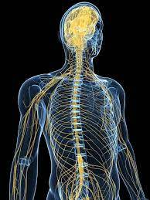
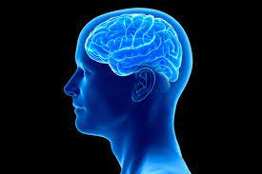
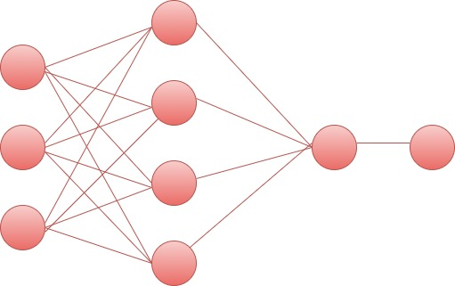
Invention of Deep Learning
Deep Neural Network
:-
Inspiration

Slide 4

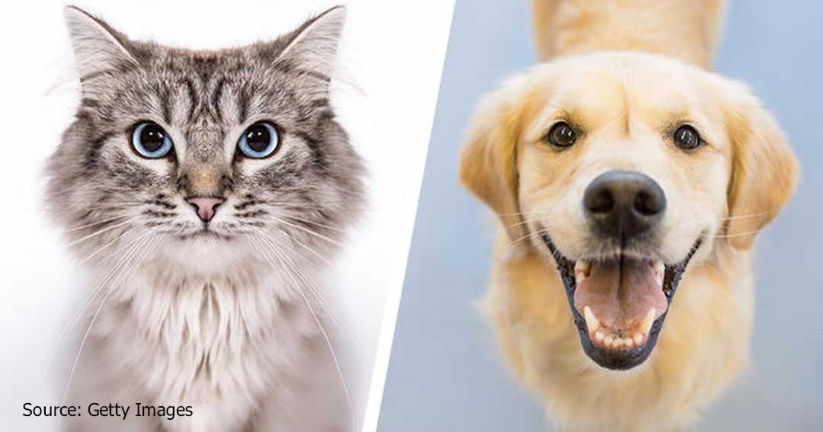
Deep Learning vs in Machine Learning
Unstructured Data
No need of data processing
Huge computation
Structured Data
Need much Data Pre-Processing
Small Computation
ID | A | B | Ans
1 | 4 | 0 | 0
2 | 6 | 1 | 1
3 | 8 | 0 | 0
Images, Audio Frequency
.csv file, Excel Sheet

Slide 5

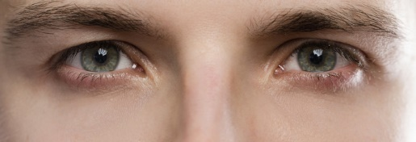
Neural Network Architecture Building I
Input Nodes
As
Input Layer

Slide 6
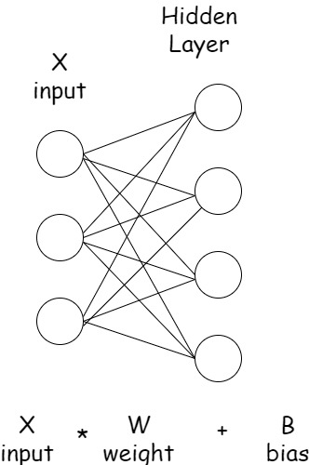
Neural Network Architecture Building II

Slide 7
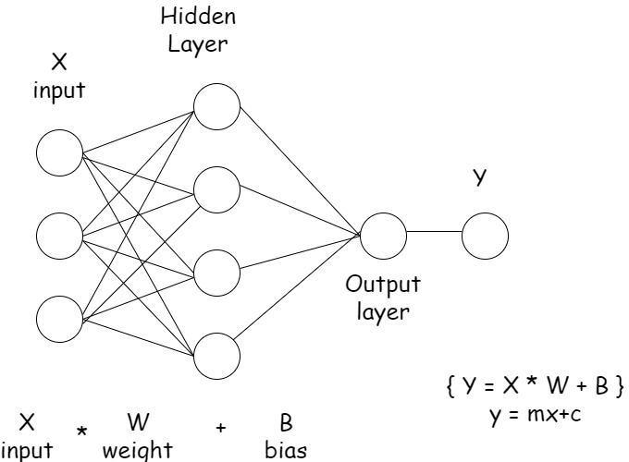
Neural Network Architecture Building III

Slide 8
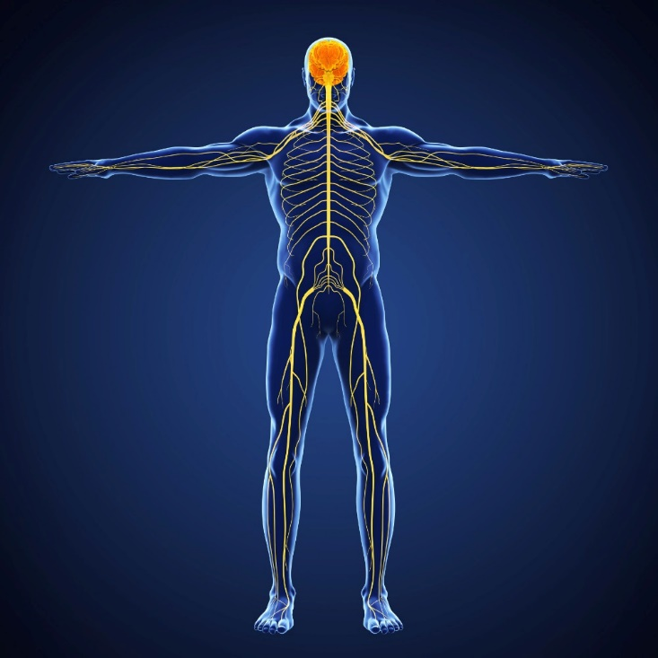
Neuron
Activation

Slide 9
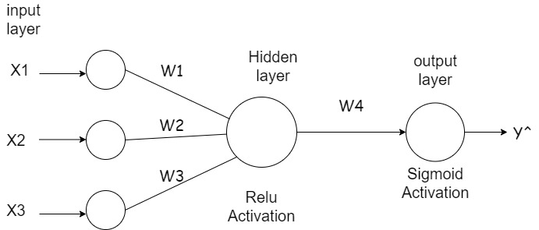
y = m * x + c
y = X1.W1 + X2.W2 + X3.W3 + bias
Z = Activation (y)
X (input) * W(weights) + B(bias)
Activation(X (input) * W(weights) + B(bias))

Slide 10
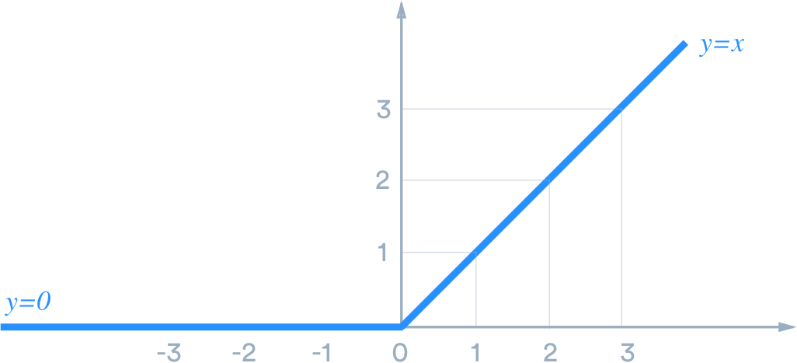
Relu Activation
Rectified Linear Unit
y = X1.W1 + X2.W2 + X3.W3 + bias
Z = Activation (y)
Z = Max (0 , y)

Slide 11
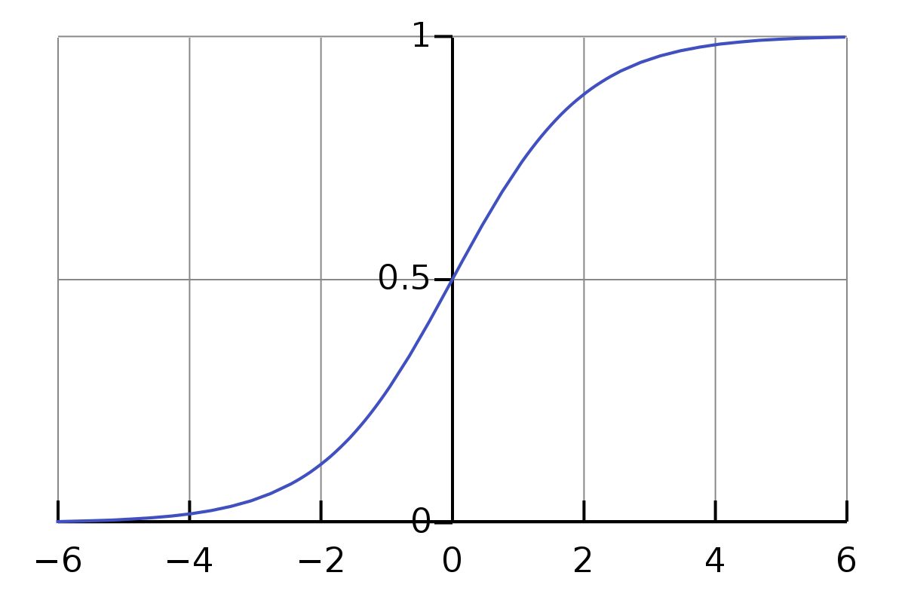
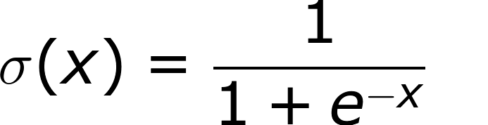
Sigmoid Activation
will transform any value in
Between 0 and 1
y = X1.W1 + X2.W2 + X3.W3 + bias
Z = Activation (y)

Slide 12
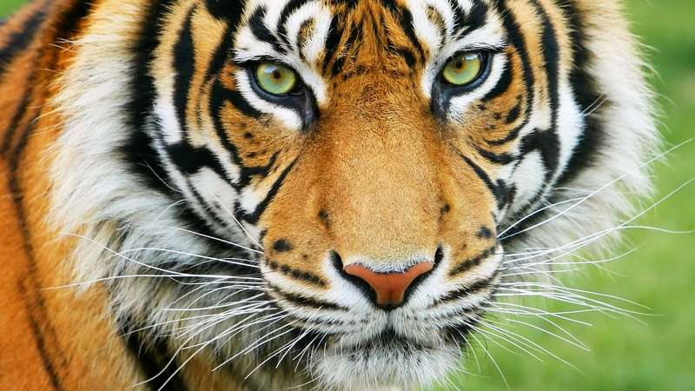
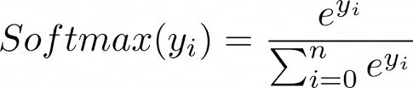
For multi class classification we get Probability
for each class
}
Tiger
0.70
Cat
0.20
Dog
0.10
Softmax Activation
y = X1.W1 + X2.W2 + X3.W3 + bias
Z = Activation (y)

Slide 13
How to choose Activation Function ???
Hidden Layer : Relu
Output Layer
if Classification is Binary:
Sigmoid Activation(Yes/No)
if Classification is Multiple Class:
Softmax Activation(A/B/C)

Slide 14
BMI | GLUCOSE | BLOOD PRESSURE | Diabetes
33.6 | 148 | 72 | 1
y = X1.W1 + X2.W2 + X3.W3 + bias
Z = Activation (y)
Predicted : 0
Actual : 1
Loss = (y – y^)2
Aim is to minimize
the loss value
using
Optimizer

Slide 15
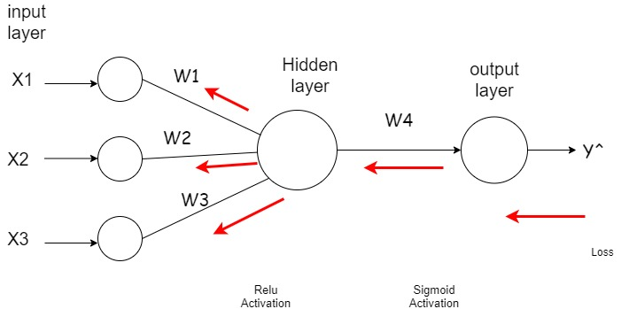
To minimize loss Update Weights…
Weight upation formula:
W-new = W-old – LR * d(loss)/d(W-old)

Slide 16
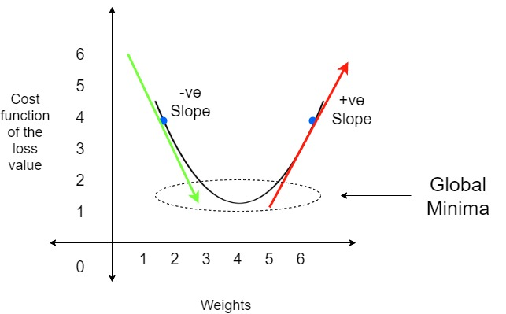
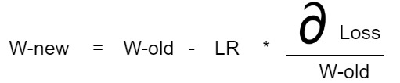
Gradient Descent
If LR is larger…!!!
Ex: 1
If LR is smaller…!!!
Ex: 0.01 , 0.001

Slide 17
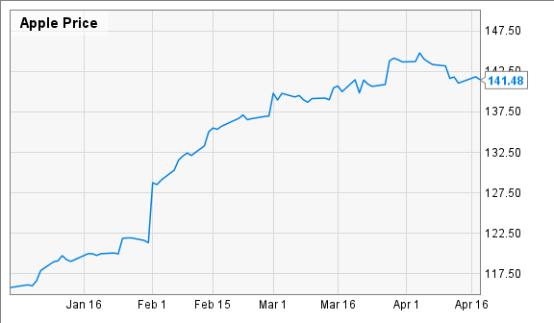
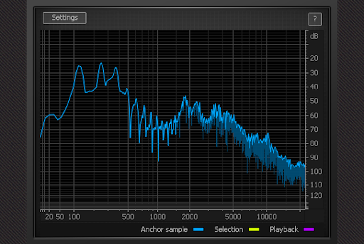
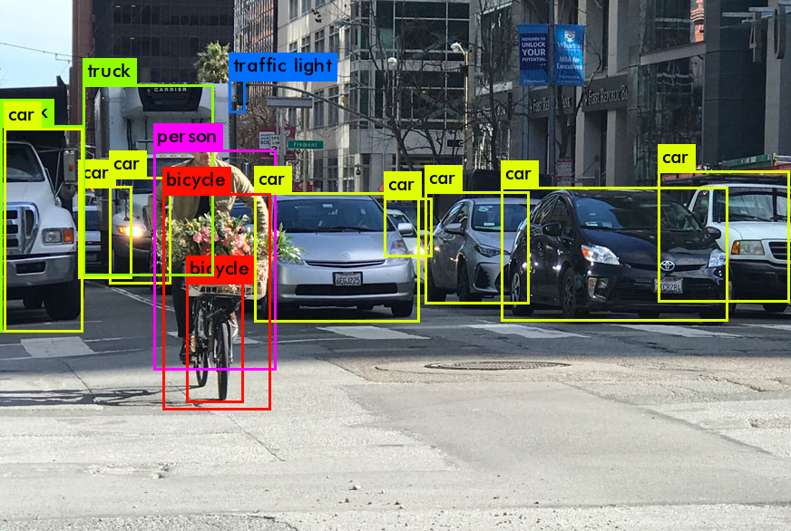
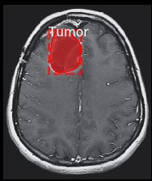
for classification
CNN – Convolutional Neural Network
for sequential data
LSTM – Long Short Term Memory
RNN – Recurrent Neural Network
for object location
Region-CNN
Mask RCNN
Faster RCNN

Slide 18

Question Answering Round
Do not live with Question, get that Answered…!!!

